Slide 1


CHECKID
DEVICE AUTHENTICATION
PROCESS FOR BIOMETRICS

Slide 2




CONTENTS
Overview
CheckID use cases
Terminal Authentication
Biometric Authentication
CheckID Card Reader
Why use CheckID?

Slide 3

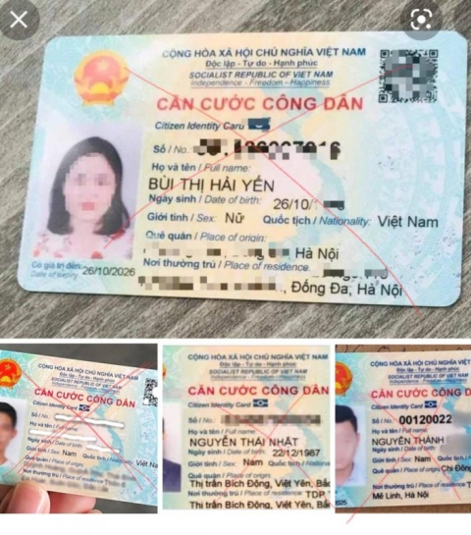

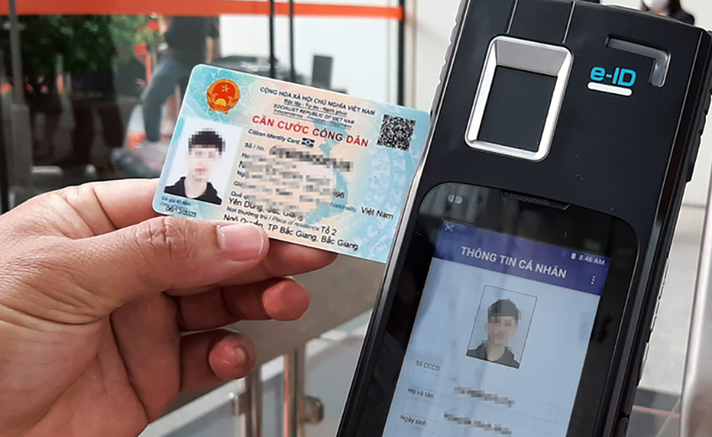

OVERVIEW
As technology advances, identity fraud in the authentication process becomes more sophisticated and increasingly common.
Using pure AI to combat authentication fraud is not enough.
The transaction appraisal and approval process is costly and takes a long time.
CHECKID
The solution of the perfect combination between the Ministry of Public Security's Chip-based Citizen Identification Card authentication service and advanced AI technology.

Slide 4
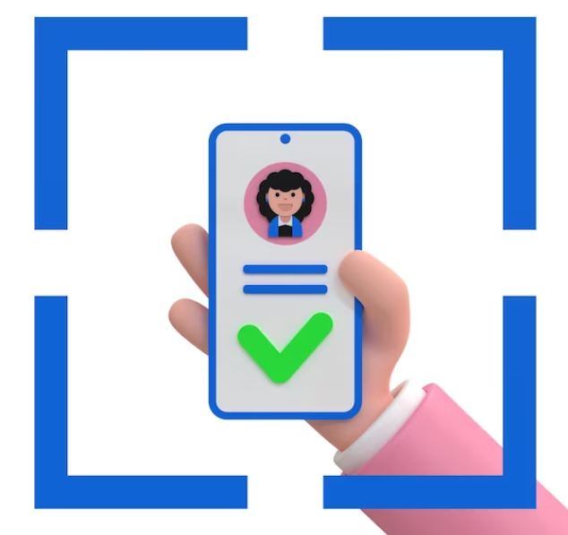
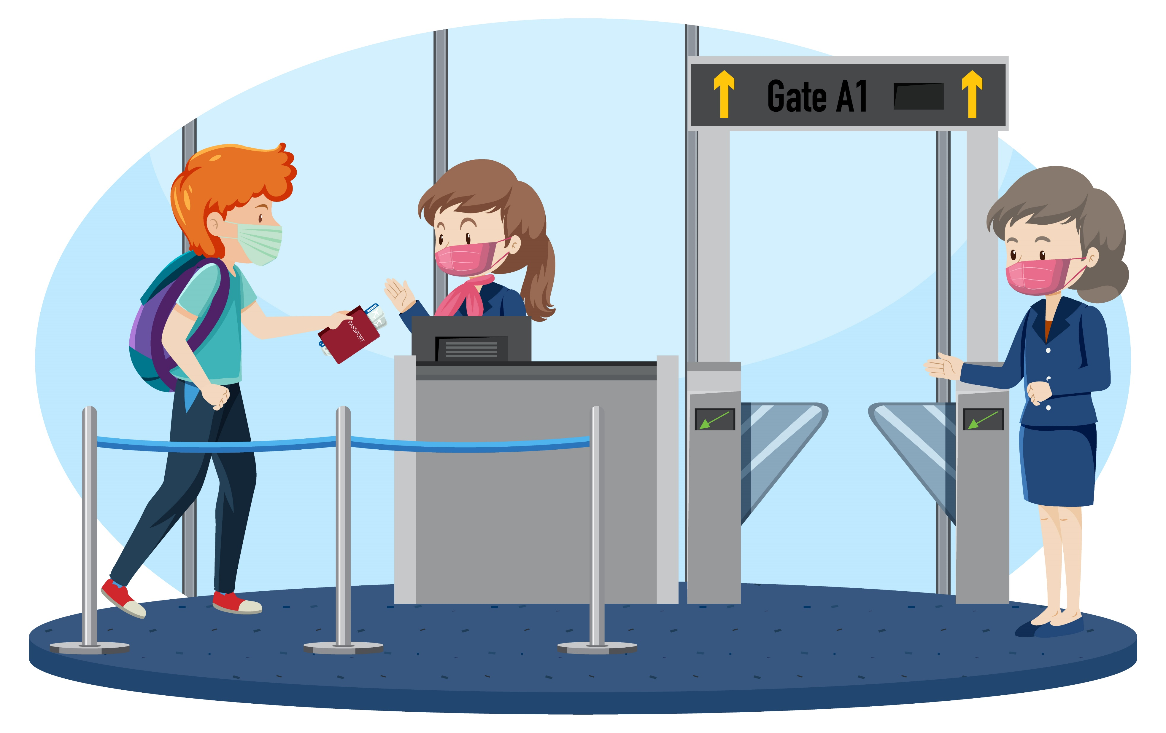
CheckID Use Cases
ONLINE
Users verify their own identity using their smartphones, usually an online process.
CheckID Customers: Vietnam Government Certification Authority, Public Certification Authority and some banks use CheckID service.
FACE TO FACE
Verification is performed by an employee with physical access to the identification document, usually as part of an identity verification process in the presence of the user.
CheckID Customers: Bank employees, police officers or airport or border control officers.

Slide 5
(TA-TERMINAL AUTHENTICATION)

Slide 6
Overview of Device Authentication (TA) Flowchart
Terminal Control Center
Terminal Client
Reader
Citizen ID Card
ID Card
Dedicated server system (HSM stores IS Digital Certificate – Inspection System)
CheckID Client
BioR502, BioR502-MRZ, CheckID-ET100
Citizen ID card, ID card
Notes:
Lưu đồ về quá trình TA (Terminal Authentication), dựa vào SequenceDiagram.org - UML Sequence Diagram Online Tool
Mô tả sơ lược từng thành phần có trong lưu đồ
Terminal Control Center
Terminal Client
Reader
CCCD gắn chip/ Passport

Slide 7
Device Authentication Process (TA)
Terminal Control Center
Terminal Client
Reader
Citizen ID Card
ID Card
Set up access control
Card Interaction :
EF Card Access
PACE or BAC
Access setup successful
Chip Authentication
Read & transmit data DG14
Chip Authentication
Access setup successful
Access setup successful
Read EF_CVCA()
Read EfCVCA & Transfer data EF.CVCA()
Receive EFCVCA()
Data EF.CVCA()
Notes:
1. Kết nối CCCD/Passport có chíp <- Chỗ này k có Hộ Chiếu (Hộ chiếu chỉ có DG1,2,11,12,EF.COM,SOD)
2.Xác thực chíp

Slide 8
Device Authentication Process (TA)
Terminal Control Center
Terminal Client
Reader
Citizen ID Card
ID Card
Find CVCA Certificate
DVCA & IS Certificate Data Exchange
SetDvCertificate() and Access Setup Successful
SetTerminalCertificate() and Access Setup Successful
verifyCertificateChain()
Interaction between Reader and Citizen ID Card/ID Card with Chip
Access setup successful
GetTerminalDataToBeSigned()
Interaction between Reader & Citizen ID Card/ID Card with Chip
Plain data to be signed with Terminal private kay
Challenge Data Collection
TA signature required
externalTerminalAuthentication()
Input: signature data
Verify TA signature
Returns TRUE (or) FALSE
Extract DG3 (fingerprint) and DG4 (iris) data
Returns TRUE (or) FALSE
Returns TRUE (or) FALSE
Notes:
3. Thực hiện TA, trong quá trình TA gồm các bước
+ Trao đổi dữ liệu certificate: DVCA certificate, IS certificate <- Chỗ này có CVCA Certificate nữa
+ Thu thập challenge (quá trình tương tác giữa Reader và CCCD có chíp)
+ Yêu cầu chữ ký TA (TA signature - quá trình tương tác giữa Terminal Client và Terminal Control)
+ Xác thực chữ ký TA (quá trình tương tác giữa Reader và CCCD có chíp)
--> Kết quả của quá trình xác thực chữ ký TA (true/false), trường hợp true thì sẽ tương tác được dữ liệu DG3 và DG4

Slide 9
TCC Digital Certificate Issuance and Renewal Process (Central Service RAR-C06 Certificate Management System)
C06-RAR CMS
Terminal Control
C06-RAR CMS
Terminal Control
Gen Key
Existed Key
Submit information
CVC Request
Submit information
CVC Request
IS Certificate
IS Certificate
DVCA Certificate
DVCA Certificate
CVCA Certificate
CVCA Certificate
Digital Certificate Issuance Process
IS Digital Certificate Renewal Process (once a month)
Notes:
1. Kết nối CCCD/Passport có chíp <- Chỗ này k có Hộ Chiếu (Hộ chiếu chỉ có DG1,2,11,12,EF.COM,SOD)
2.Xác thực chíp

Slide 10

BIOMETRIC AUTHENTICATION PROCESS

Slide 11


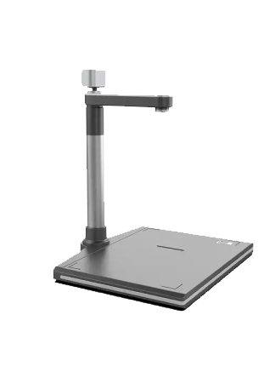
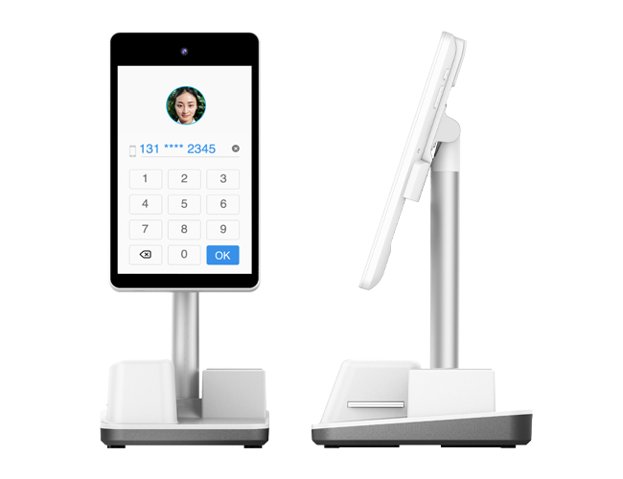
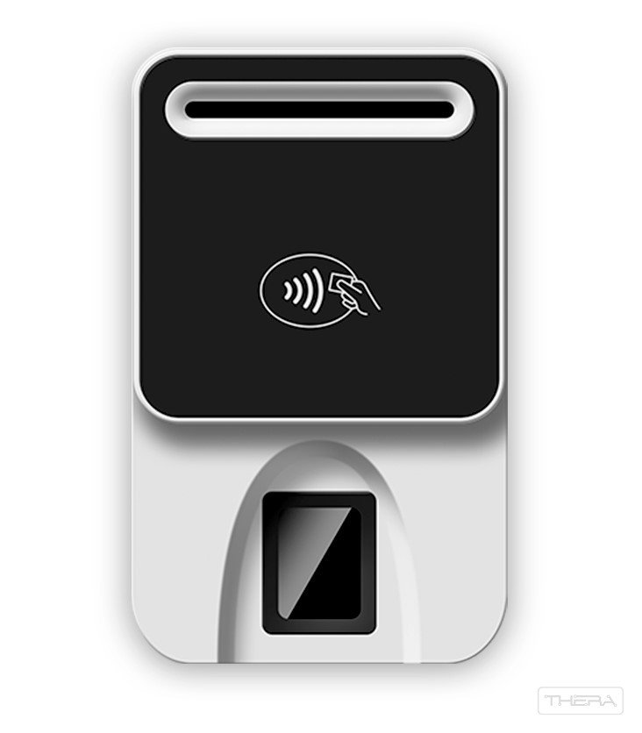

Biometric Authentication Process
Terminal Control Center
Terminal Client
Read ID card, fingerprint (DG3) and iris (DG4)
Call for Access Token
Match DG3 and DG4 in database on Dedicated Server System
Transmit fingerprint or iris data
Match
Successful Results
No Match
Result Failed
Notes:
1. Dữ liệu thẻ CCCD được đọc
2. Terminal Client gọi Terminal Control để lấy AccessToken
3. Terminal Client truyền số CCCD/Passport + DG3/DG4 lên Terminal Control để thực hiện xác thực
4. Terminal Control trả về kết quả xác thực thành công/thất bại

Slide 12

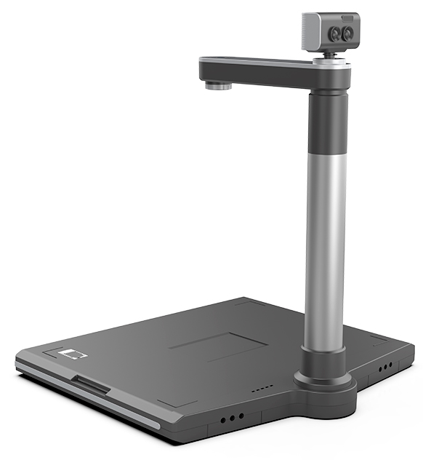
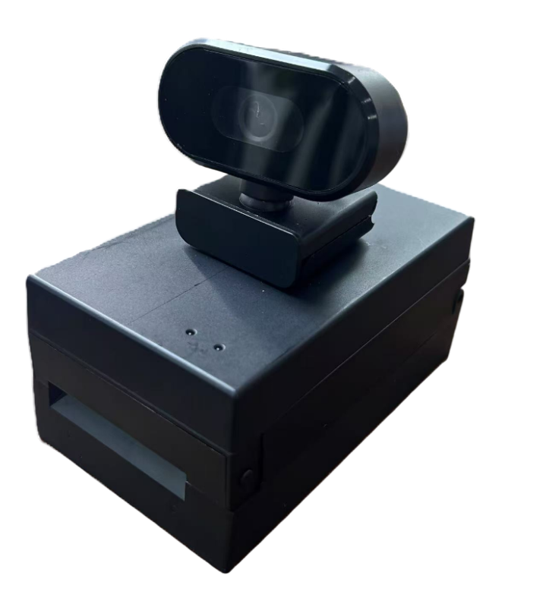
Đầu đọc thẻ CheckID
BioR502
BioR502-MRZ
CHECKID-SR
CheckID ET100

Slide 13
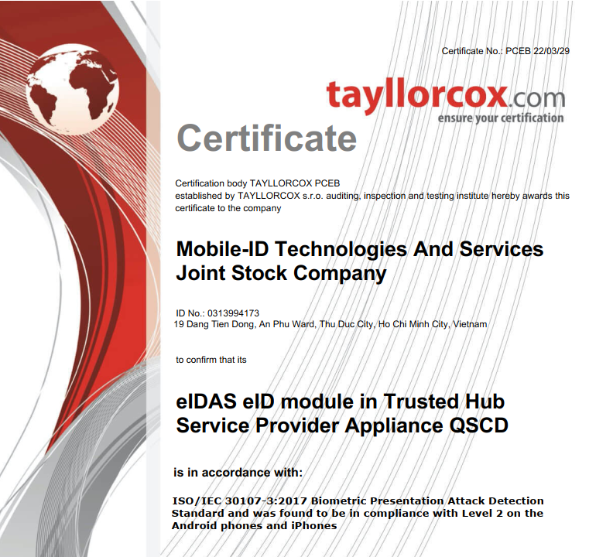
eKYC Technology Compliant with ISO 30107 International Standard

Slide 14
Why use CheckID?
Enhance customer experience
Shorten procedure time
Tackling the Fraud Problem
Transparency in information verification
Save Operating Costs
A smarter and more convenient way to get the job done faster.

Slide 15
CHECKID BENEFITS
The authentication results are absolutely reliable.
Straightforward processing, with data retrieved from the Chip available as signed XML, pdf, JSON without manual backend processes.
Extract data without OCR errors or manual typing errors
Anti-fraud with high-resolution facial images taken from Chip.
Chips are resistant to cloning, based on the highest cryptographic standards.

Slide 16





Thanks for watching!
MOBILE-ID TECHNOLOGIES & SERVICES JOINT STOCK COMPANY
Level 9, Thuy Loi 4 Building, 286-288 Nguyen Xi street, Ward 13, Binh Thanh District, HCM City
028 3622 2982
info@mobile-id.vn

